Slide 1
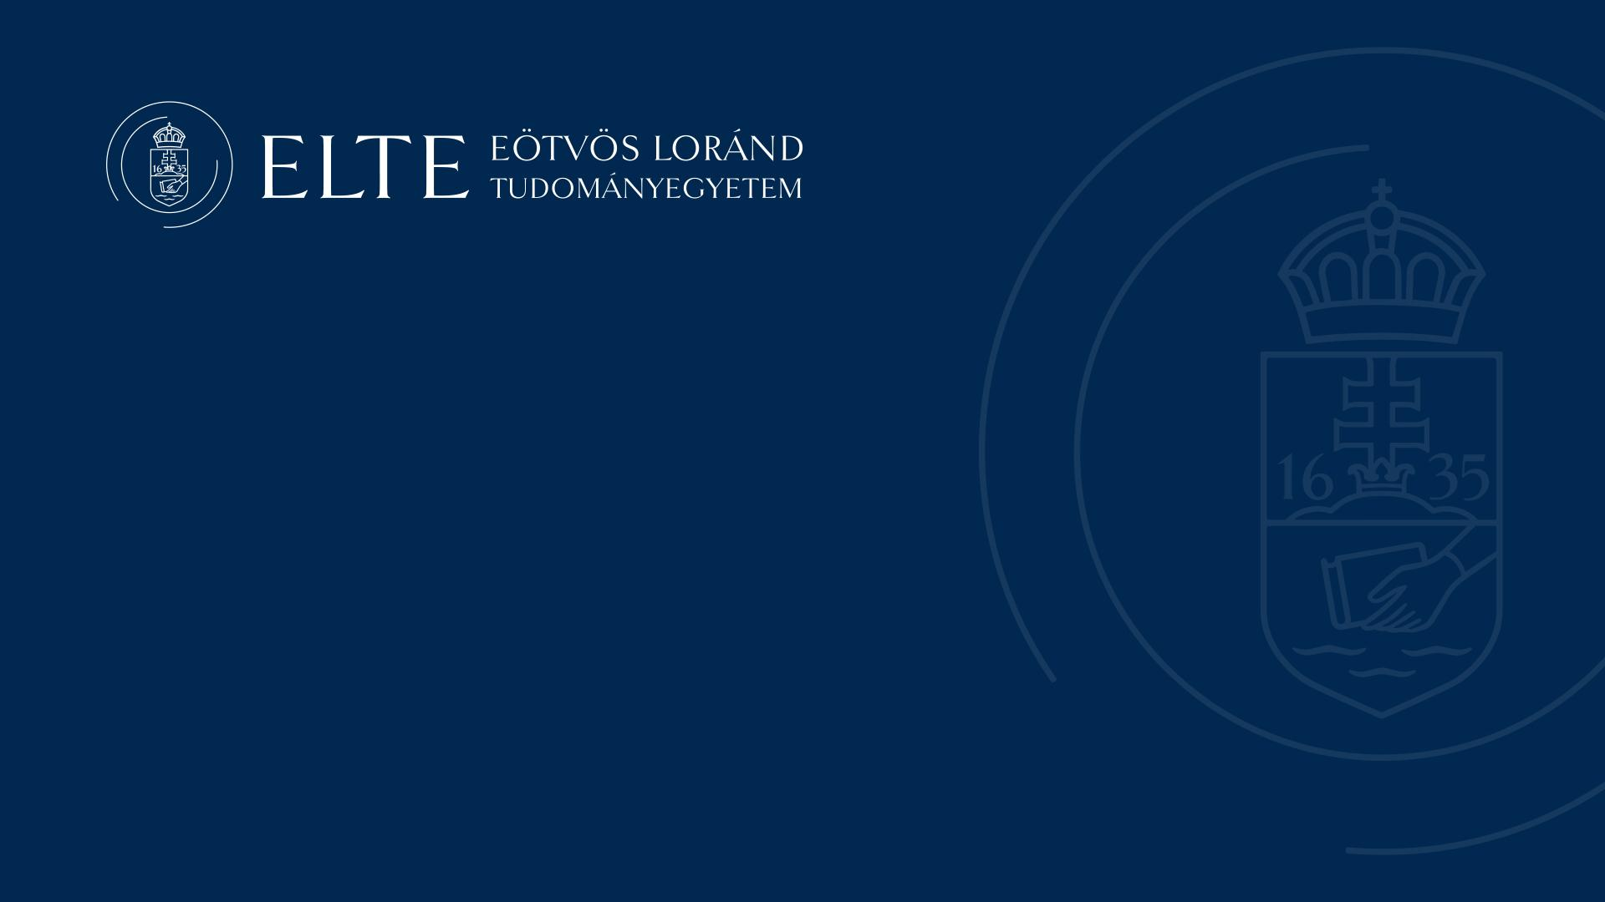
Iranian Studies at ELTE
Iranisztika az ELTE-n
ایرانشناسی در الته

Slide 2
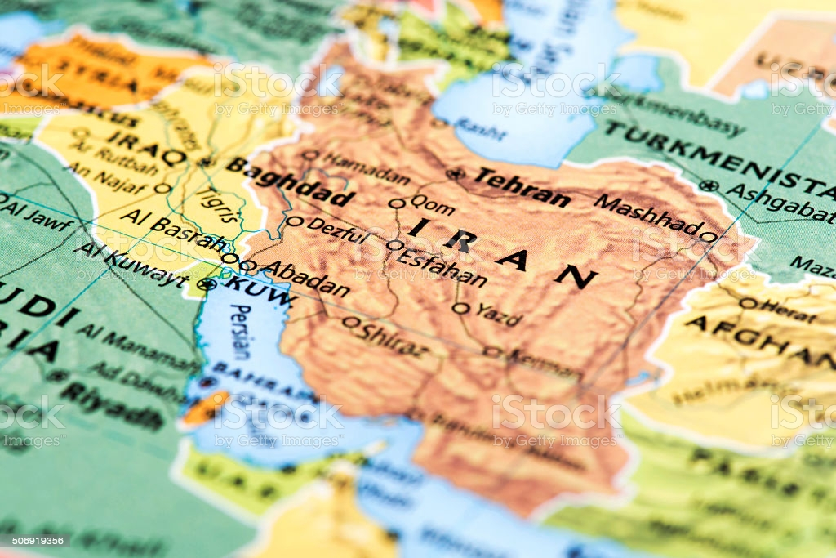

Iranian Studies deals with the study of Iranian languages (e.g. Persian) and peoples
Notes:
Iranian Studies, also known as Iranology, is an interdisciplinary field that deals with the study of Iranian languages and peoples. University students will realise that the main focus of this field is Persian, the official language of modern Iran. Yet it covers a vast area of study involving the research of all Iranian languages and written sources and also Iranian peoples’ history and culture. It is not geographically limited to the territory of contemporary Iran but includes territories that were under Iranian influence during history. For instance, besides Iran itself, in the East, Uzbekistan, Tajikistan, Afghanistan, Pakistan and India are as much part of Iranian studies as Armenia and Turkey in the West. This discipline covers a large area not only geographically but also in terms of time. It encompasses a period of thousands of years, from the earliest written sources to contemporary events.

Slide 3
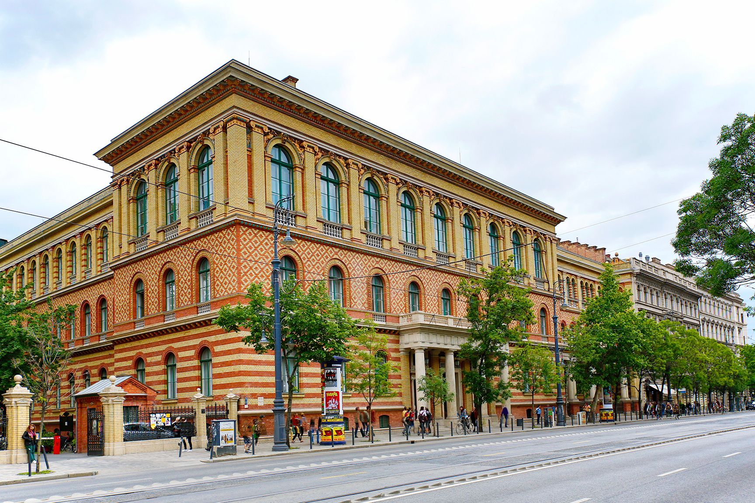
Iranian Studies has been taught at ELTE since 1958
Notes:
Iranian studies as a field of study in its own right has been present in the humanities for hundreds of years as one of the earliest representatives of traditional humanities. The development of this field of study was closely linked to the research of Indo-European comparative linguistics, of which the study of Iranian languages, especially Persian, was an essential element.
The Iranian studies as a separate program has been taught at the Faculty of Humanities at Eötvös Loránd University since 1958.

Slide 4
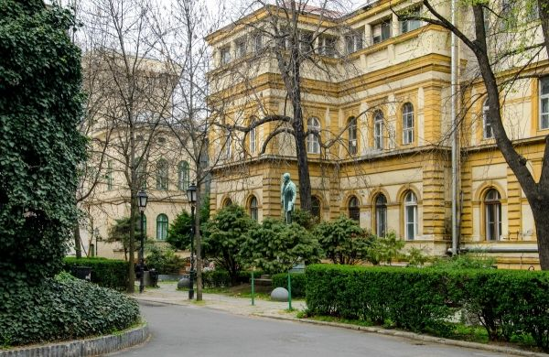
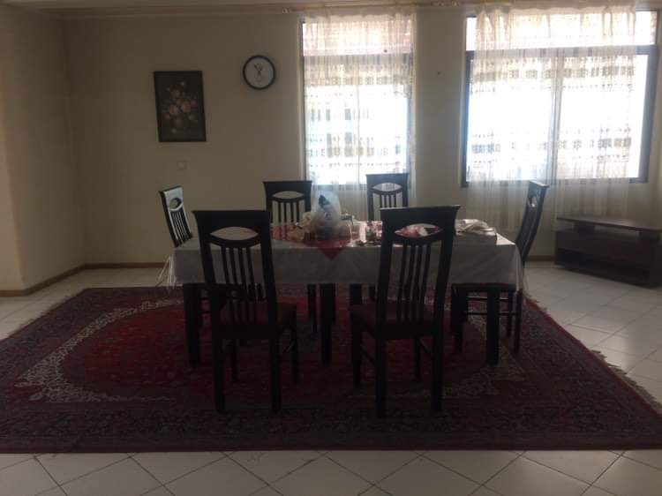
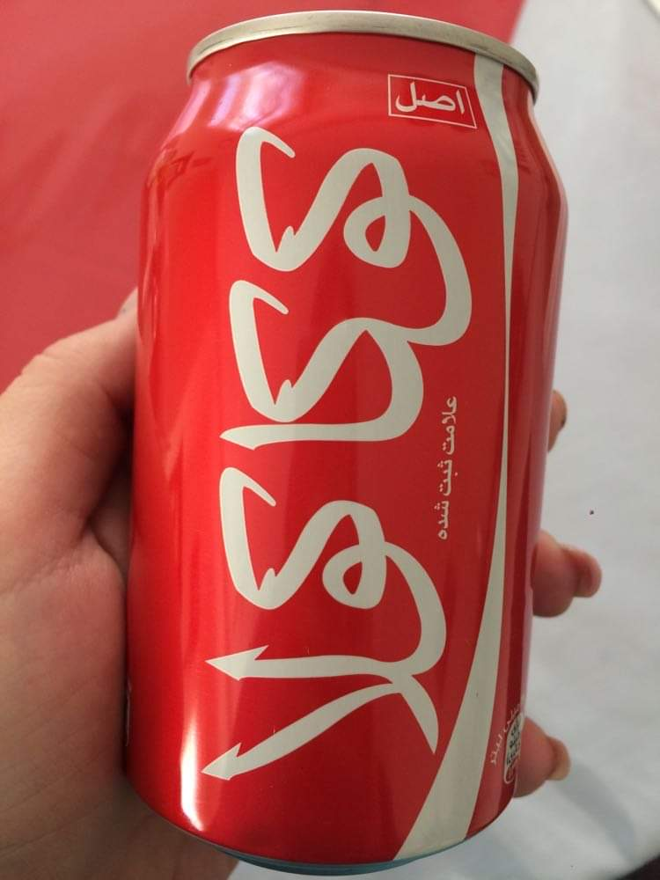


Slide 5

دانشجویان می توانند در سه مقطع کارشناسی، کارشناسی ارشد و دکترا در این رشته تحصیل کنند
Notes:
دانشجویانی که مایل به تحصیل در ایرانشناسی هستند باید بدانند که این دانشکده یکی از قدیمی ترین و معتبرترین دانشکده های دانشگاه الته است. دانشجویان می توانند در سه مقطع کارشناسی، کارشناسی ارشد و دکترا در این رشته تحصیل کنند. بسیاری از استادان این دانشکده در زمینه های گوناگونی مانند ادبیات و هنر، چهره های سرشناس بین المللی هستند.

Slide 6
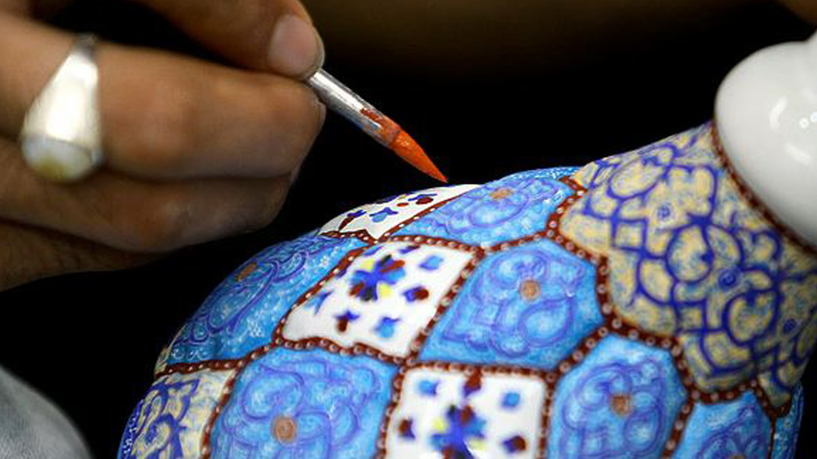
این دانشکده بافتِ جالبی از استادانِ با تجربه و با اَنگیزِه و دانشجویان جوان و پُر انرژی دارد
Notes:
این دانشکده بافتِ جالبی از استادانِ با تجربه و با اَنگیزِه و دانشجویان جوان و پُر انرژی دارد. این فضا برای آموزش نسل جوان بسیار سودمند است. همه ی دانشجویان باید درسهای مشترک پایه را بگذرانند ولی می توانند برای پایان نامه های خود موضوع هایی انتخاب کنند که در راستای علاقه و یا شغل آینده آنها باشد.

Slide 7
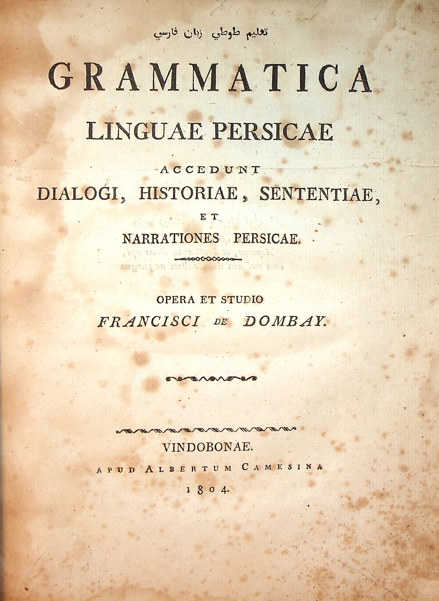
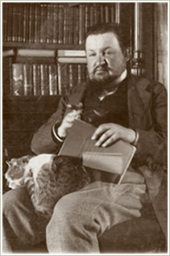
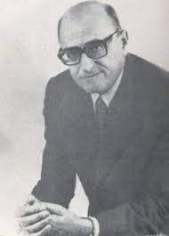
Ferenc Dombay
Sándor Kégl
Zsigmond Telegdi
Notes:
The beginnings of Iranian studies in Hungary can be traced back to at least the 18th century. Early specialists of this field include Ferenc Dombay and Károly Reviczky who earned international fame during their lifetimes. During the next century, the famous traveller Ármin Vámbéry was the first person to teach Persian language and literature at our university. One of his students was Sándor Kégl, who was an outstanding figure and leading scholar of 19th century Iranian studies in Hungary. He devoted himself to the research of Persian literature, especially the poems of Sanāʾī and Rūmī. A great scholar of Iranian studies in the 20th century was János Harmatta, whose academic work focused on Old Iranian written sources and other pre-Islamic languages. Another excellent scholar of this century was Telegdi Zsigmond. He devoted his research to Iranian linguistics and Persian literature.

Slide 8
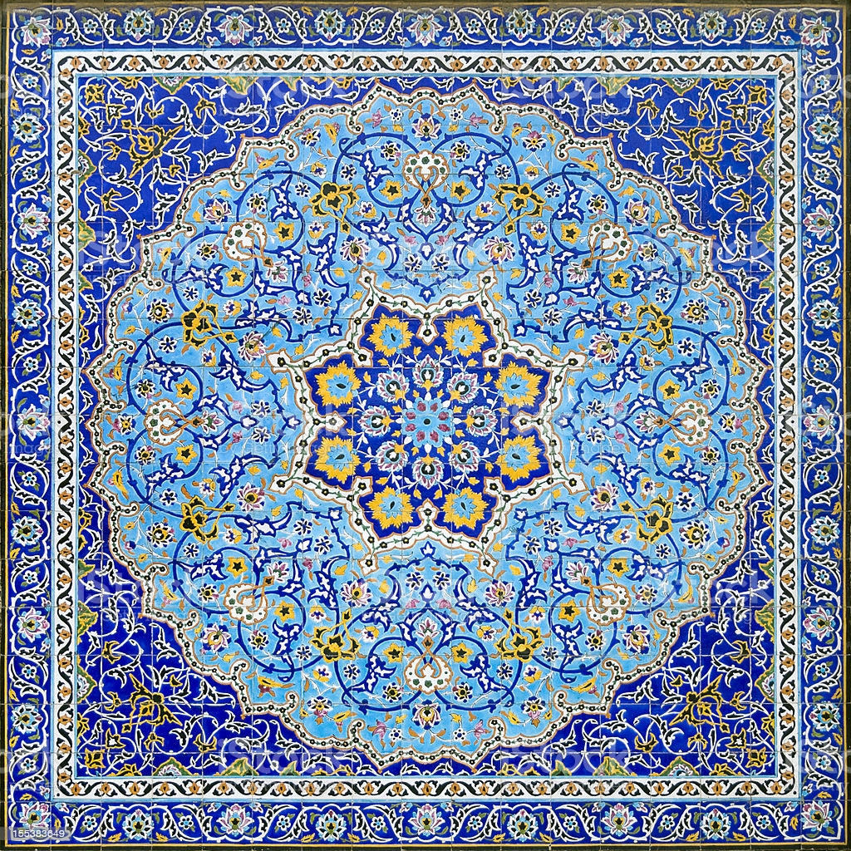
The department’s educational program
Notes:
Now let me introduce our department’s educational programmes briefly. As a separate program, Iranian studies has been taught at our university since 1958. From 2006/2007 to now, the students can study in three education levels following the Bologna system. Students learn New Persian language (both Classical and Modern Persian) during the three-year BA program from the basics to an intermediate level. In addition to language learning, students learn the basics of Persian linguistics, literature, history, art history and Islamic religion. The MA program intends to broaden and deepen this knowledge. Finally, independent research plays the most important role during the PhD program in addition to the continuous acquisition of new knowledge.

Slide 9
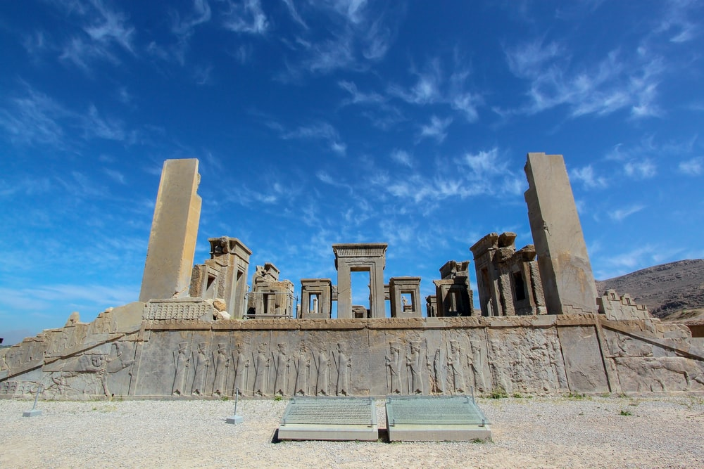
Our department has extensive relations with universities and research institutions abroad
Notes:
The Iranian Studies department has extensive relations with universities and research institutions abroad. Cambridge University, Free University of Berlin, University of Bamberg, University of Naples „L’Orientale”, University of Tehran, Academy of Persian Language and Literature and Austrian Academy of Science can be listed here by no means exhaustive.

Slide 10
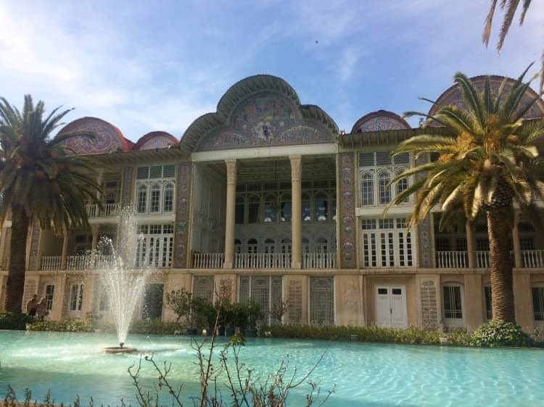
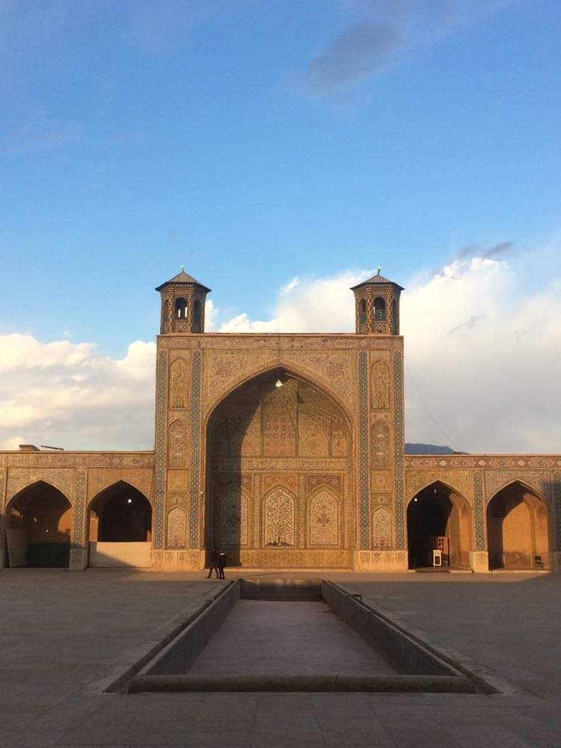
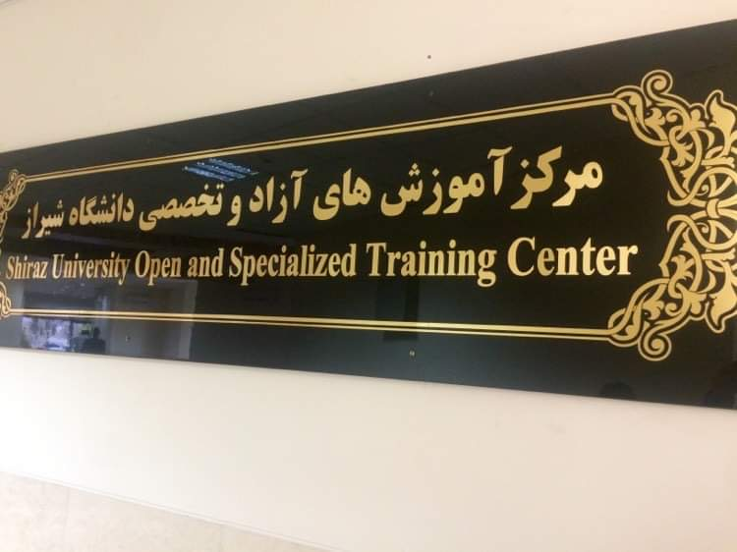
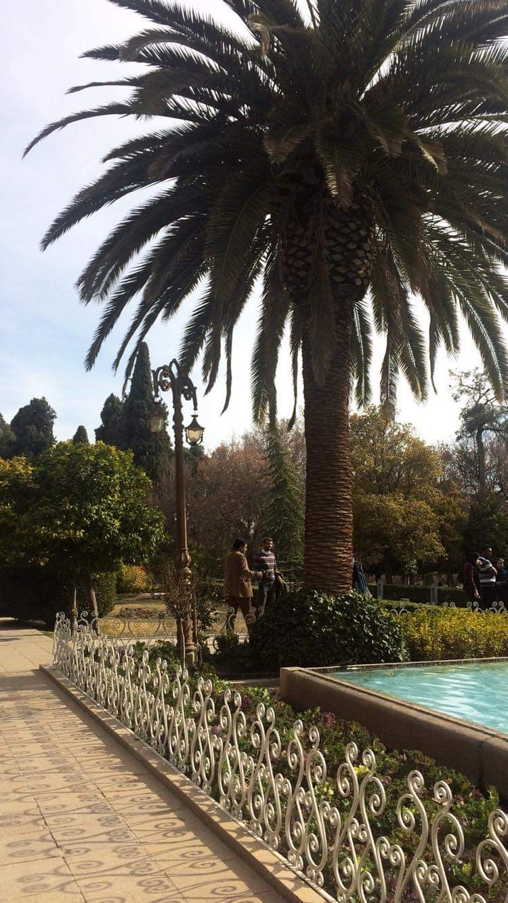
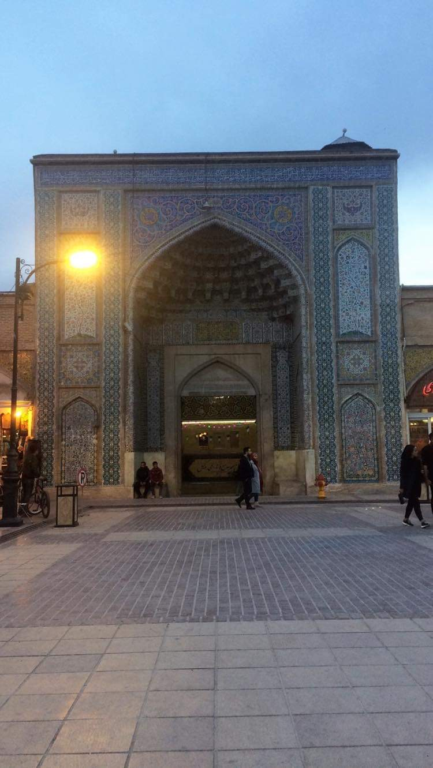
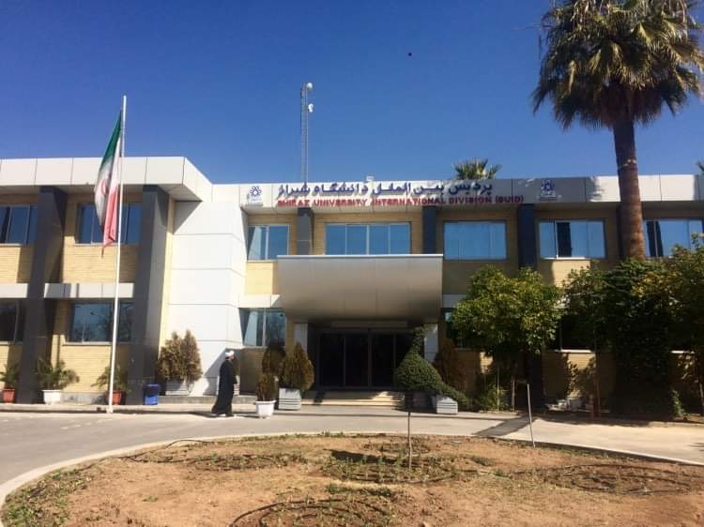

Slide 11
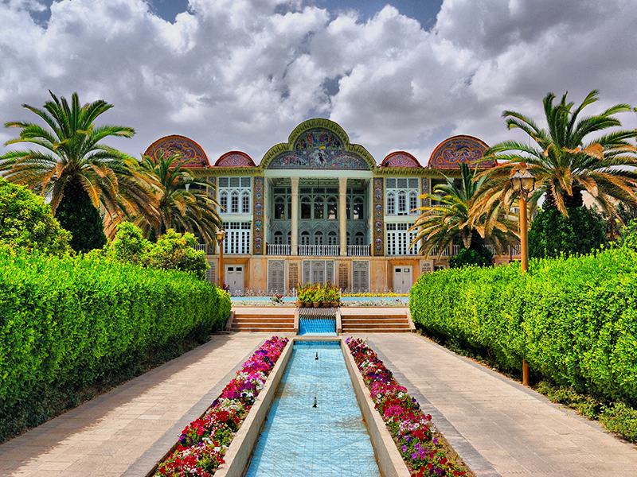
دانشجویان می توانند به عنوان دانشجوی مهمان به ایران سفر کنند
Notes:
دانشجویان کارشناسی درباره ی ادبیات، تاریخ، هنر و زبان کلاسیک و مدرن ایران خواهند آموخت. در پایان تحصیلات آنها خواهند توانست متون قدیمی را به راحتی خوانده و بفهمند. آنها، همچنین خواهند توانست به درستی با فارسی زبانان سراسرِ دنیا با استفاده از فارسی مدرن گفتگو کنند که برای دانشجویان بسیار مفید است زیرا آنها می توانند به عنوان دانشجوی مهمان به ایران سفر کنند.

Slide 12
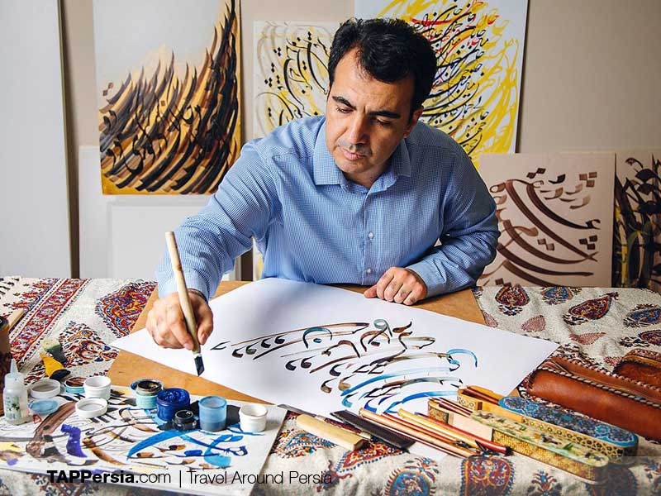
Notes:
آنها در این دوران به شهرهای تاریخی ایران سفر می کنند تا از نزدیک با طبیعت، هنر و معماری ایران آشنا شوند.
دانشجویان ایرانی عزیز، لازم است بدانید که زبان تدریس در این دانشگاه مجاری است.
Viszontlátásra az Iranisztika Tanszéken

Slide 13
Thank you for your attention!
Köszönjük a figyelmet!
ممنون از توجه شما

